Slide 1
StoryTeller Overview
This is a brief explanation of the site structure and functionality,
based on the project requirements

Slide 2

Important
This document is created on Linux based OS.
If you use another OS, some slides, text and pictures on them may look different, or not displaying properly.
Sorry Guys, but I am a big fan of Linux.

Slide 3
There are two types of Project Assignment Requirements:
Must-have
Optional

Slide 4
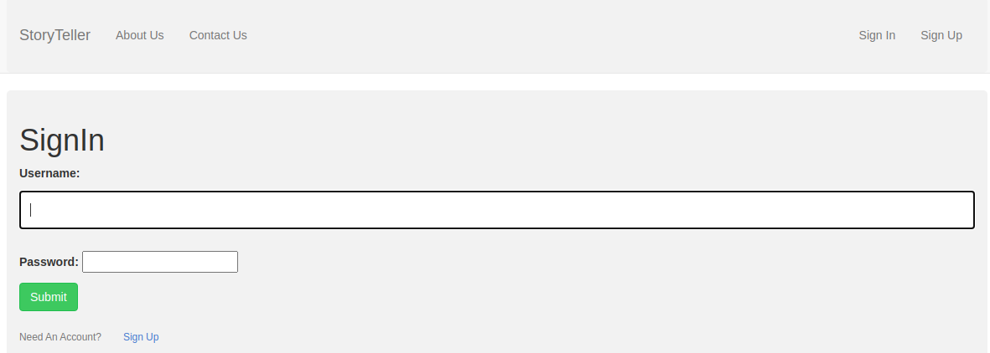
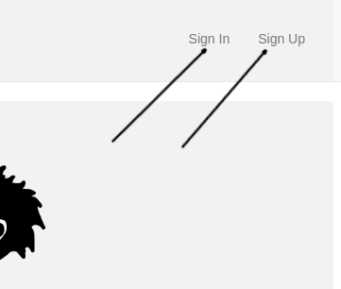
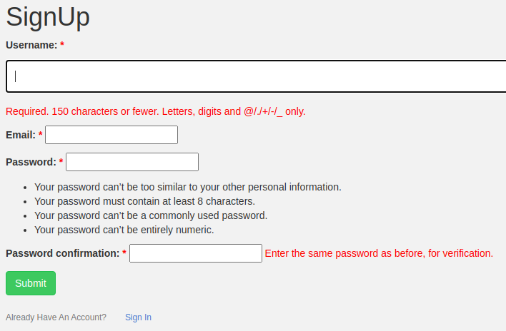
Must Have
Login and Register functionality

Slide 5
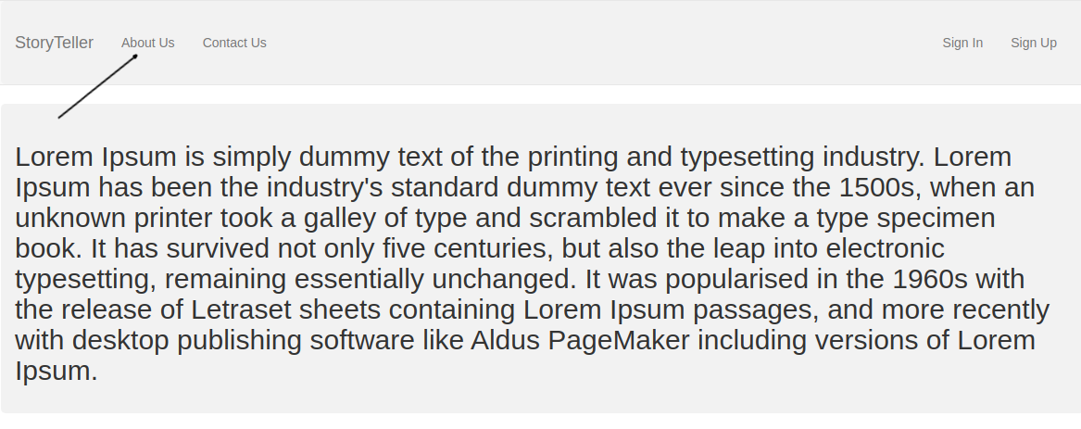
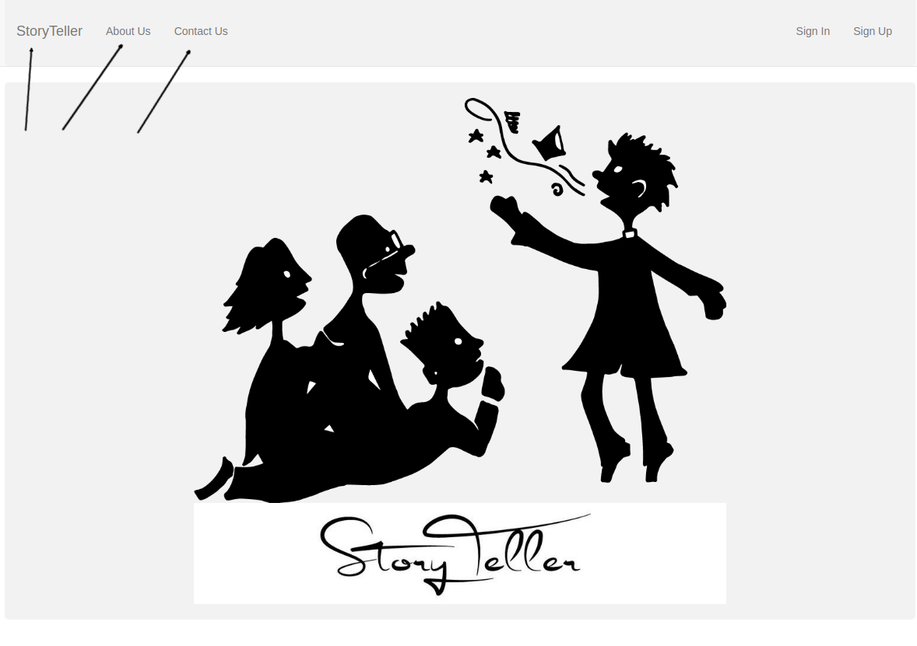
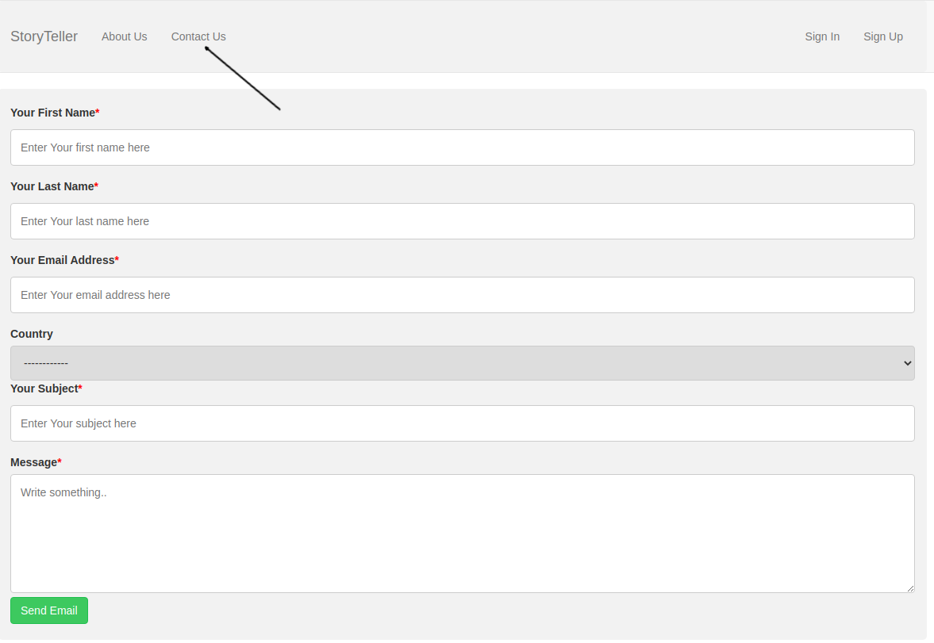
Must Have
Public Part(Landing, About and Contact Pages)

Slide 6
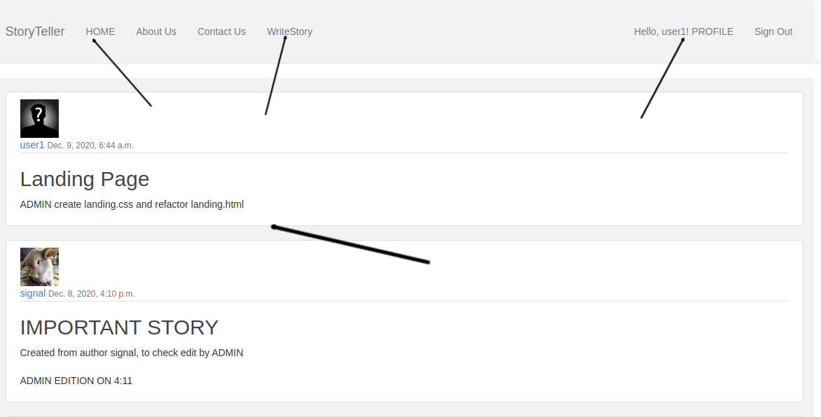
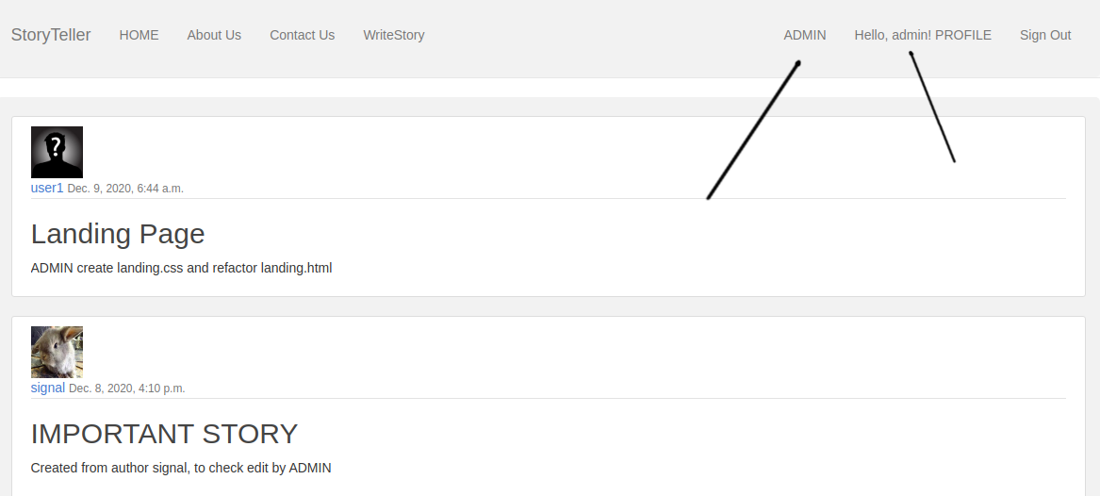
Must Have
Private Part(authenticated users and admin)

Slide 7
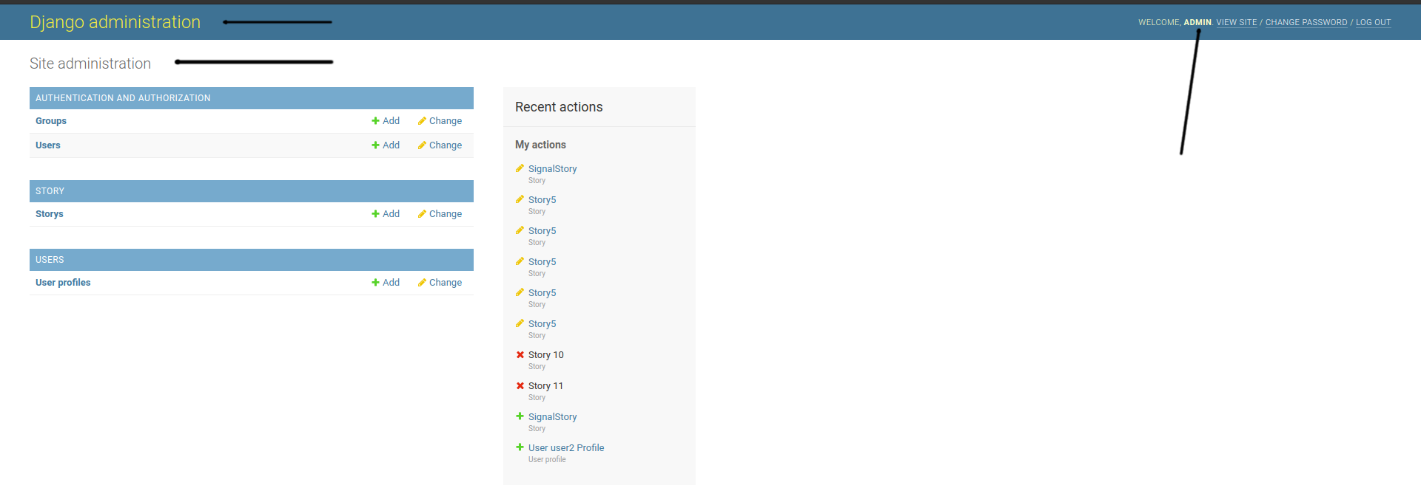
Must Have
Admin Part

Slide 8
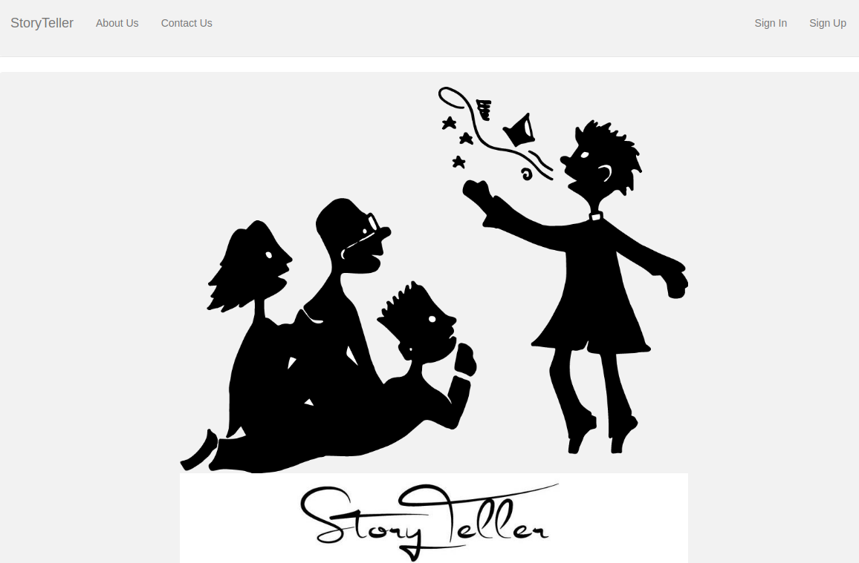
Must Have
Unauthenticated users have only get permissions- for example could see a landing page

Slide 9
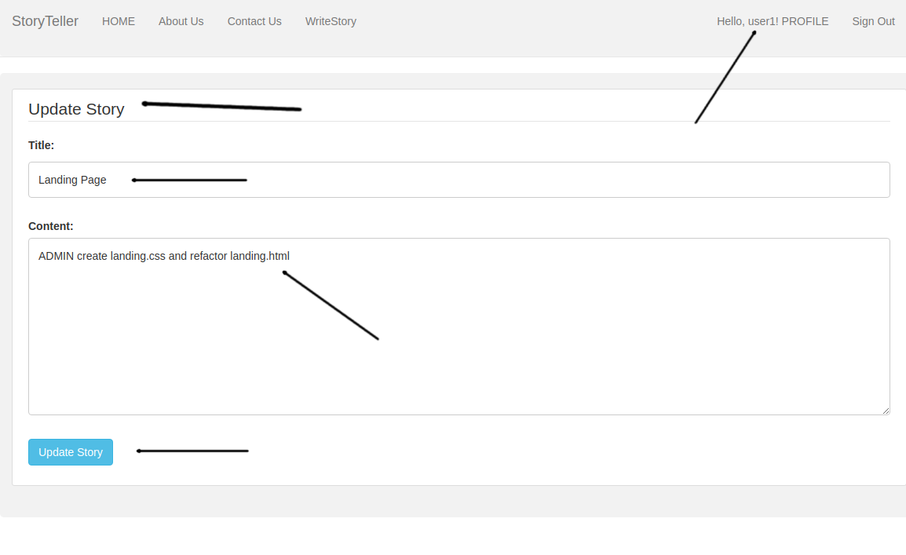
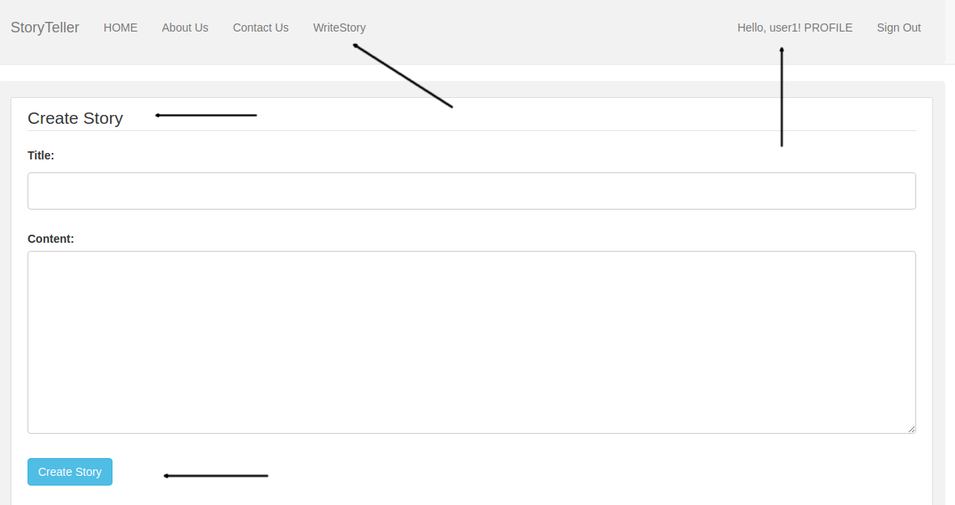
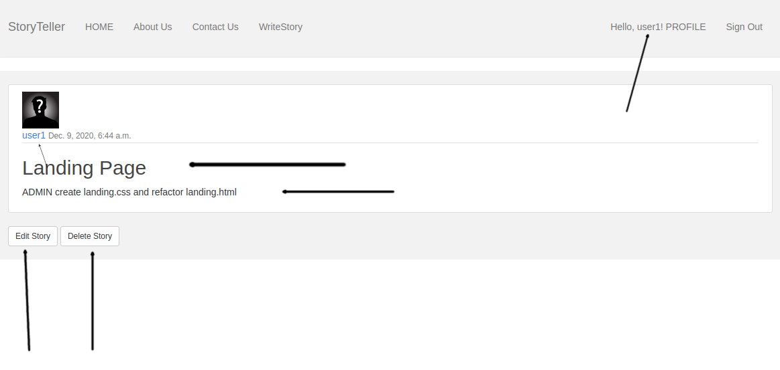
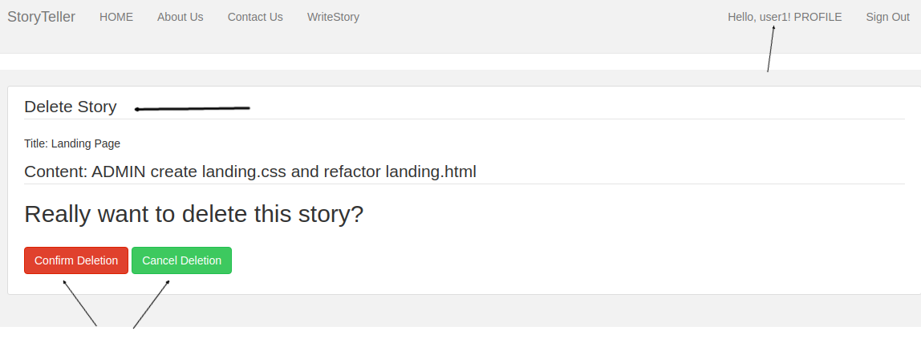
Must Have
Authenticated users have full CRUD for all of their created content

Slide 10
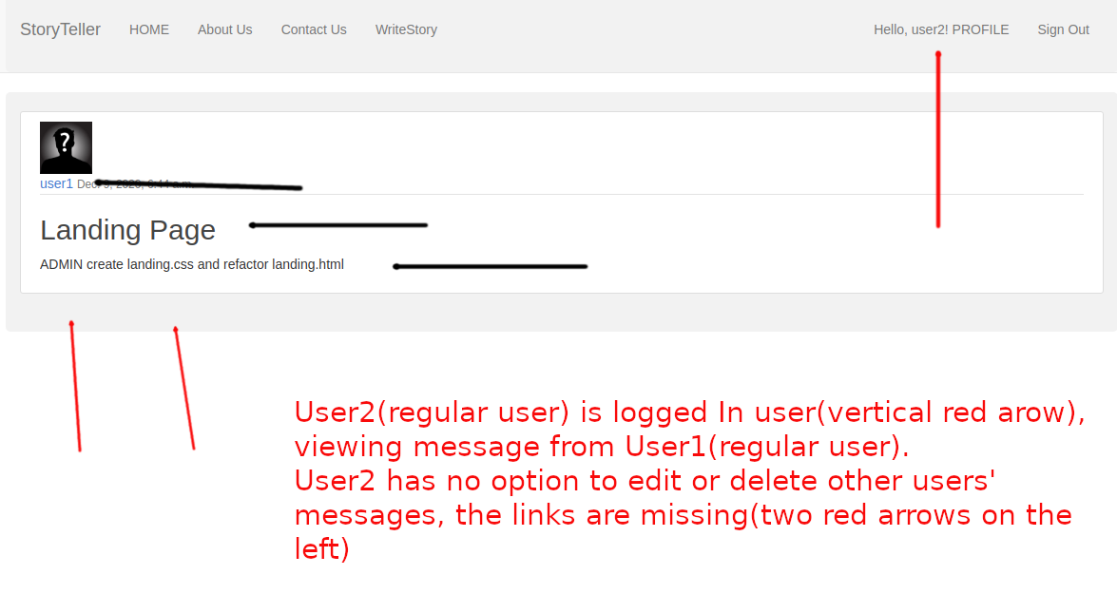
Must Have
Authenticated users have full CRUD for all of their created content(2)

Slide 11
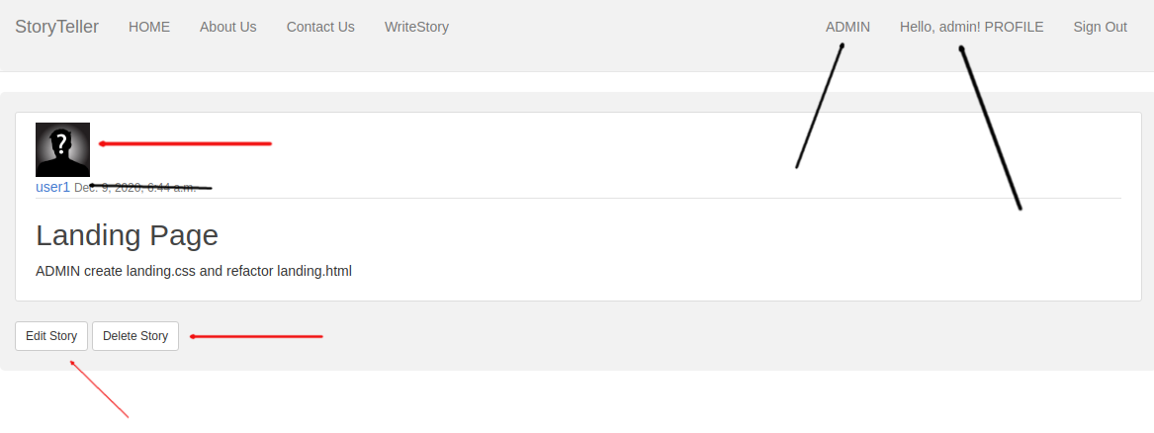
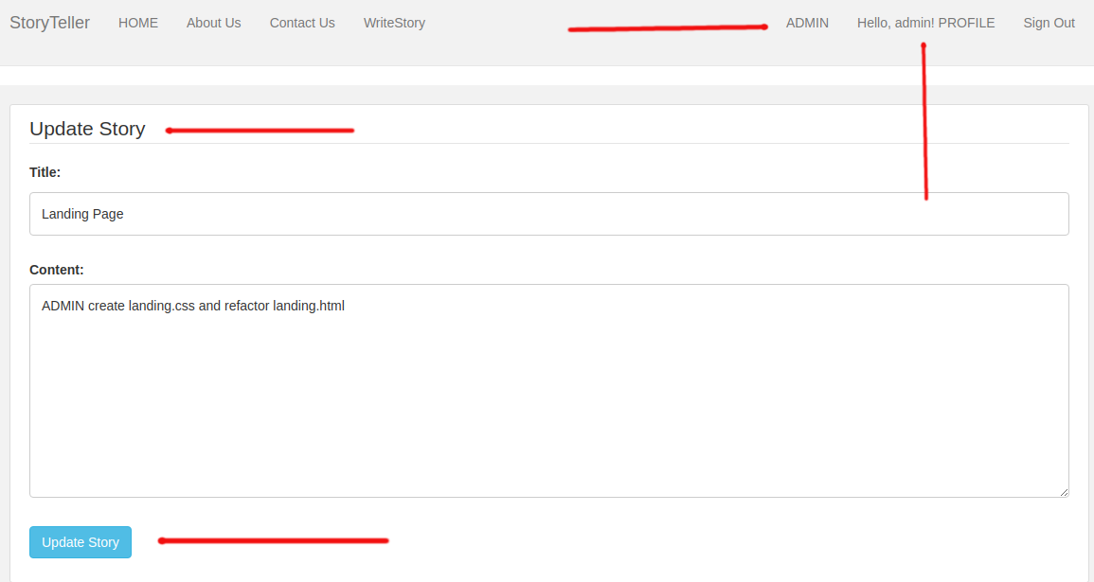
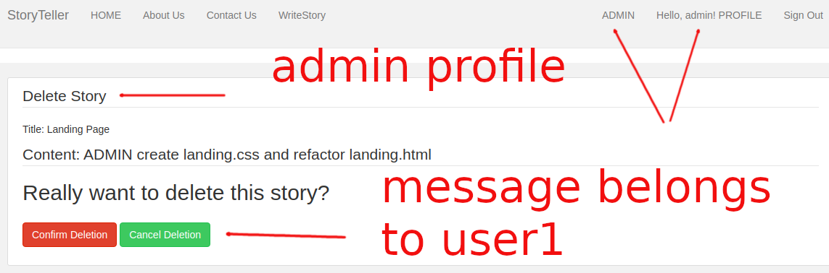
Must Have
Admin has full CRUD for all content created by users. Two ways to achieve that - first, by django administration, and second - directly from within the site. Pictures illustrate the second way(1)

Slide 12
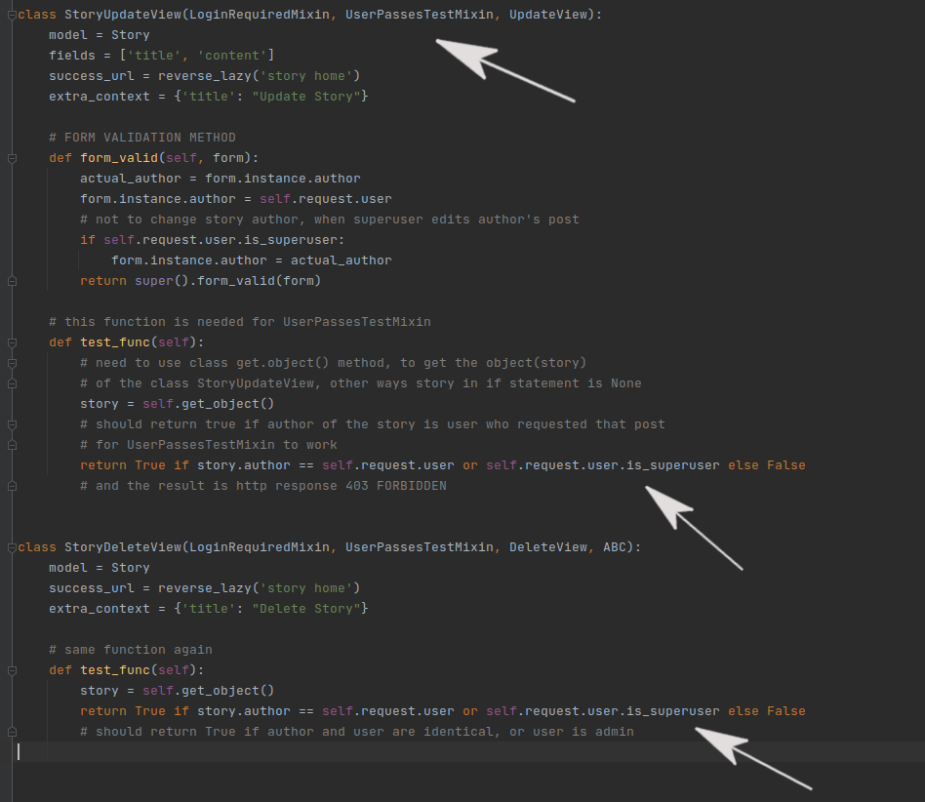
Must Have
Admin has full CRUD for all content created by users. Two ways to achieve that - first, by django administration, and second - directly from within the site. Pictures illustrated the second way(2)

Slide 13
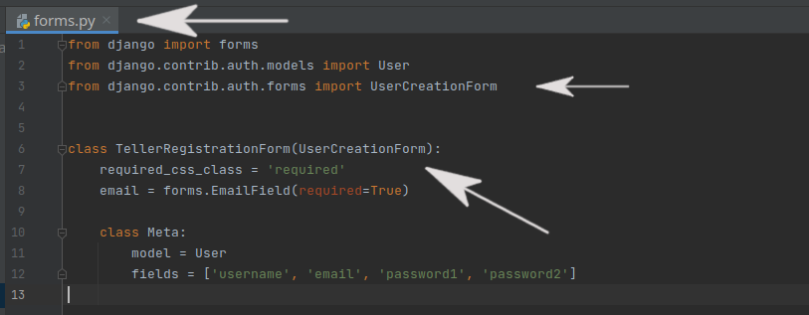
Must have
Form(for register)

Slide 14
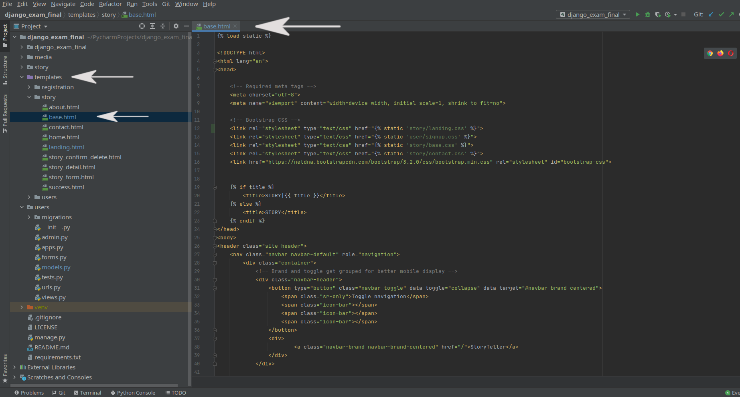
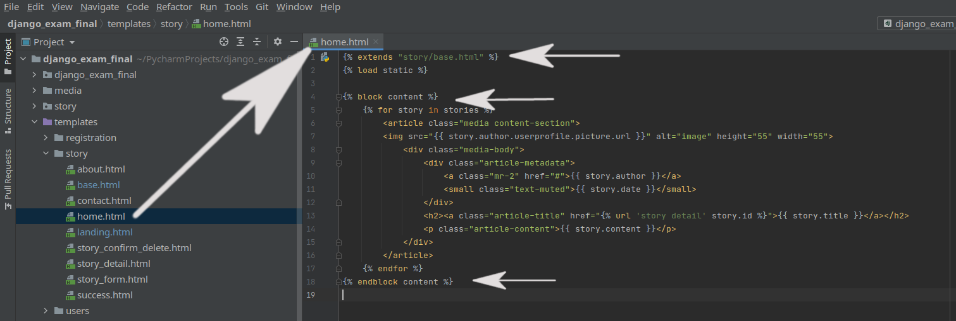
Must Have
Templates

Slide 15
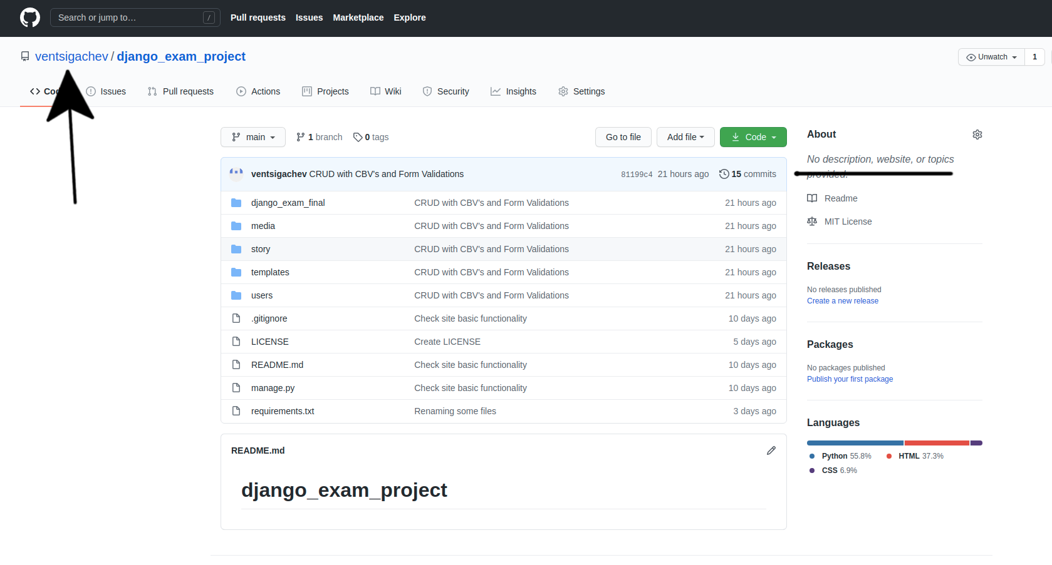
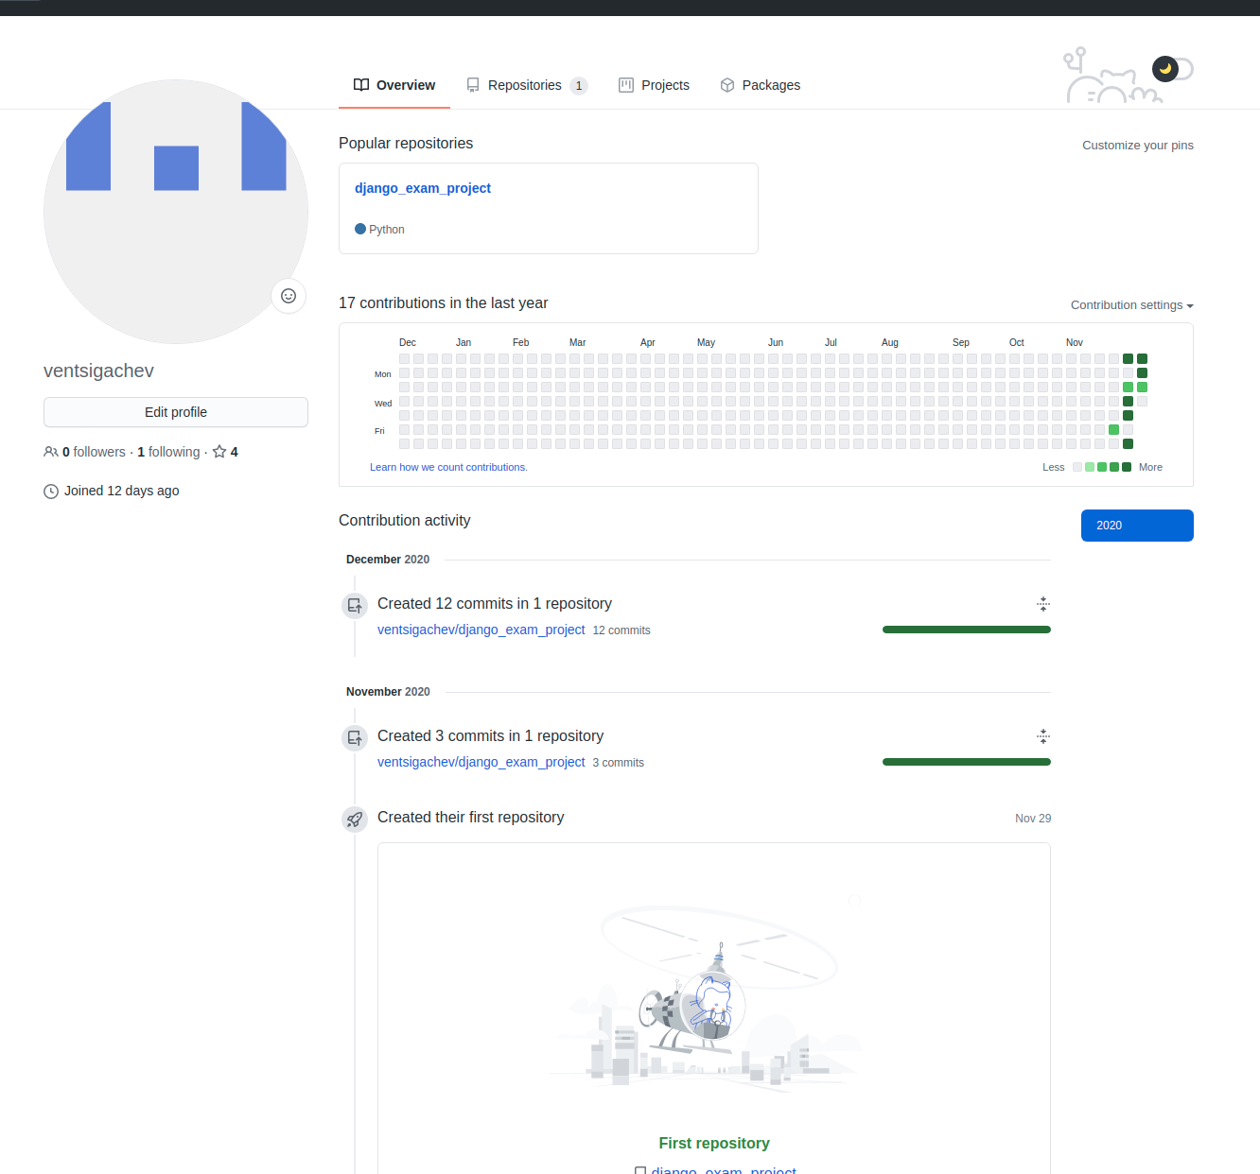
Must Have
GitHub – at least 5 commits and 5 days of history, and README

Slide 16
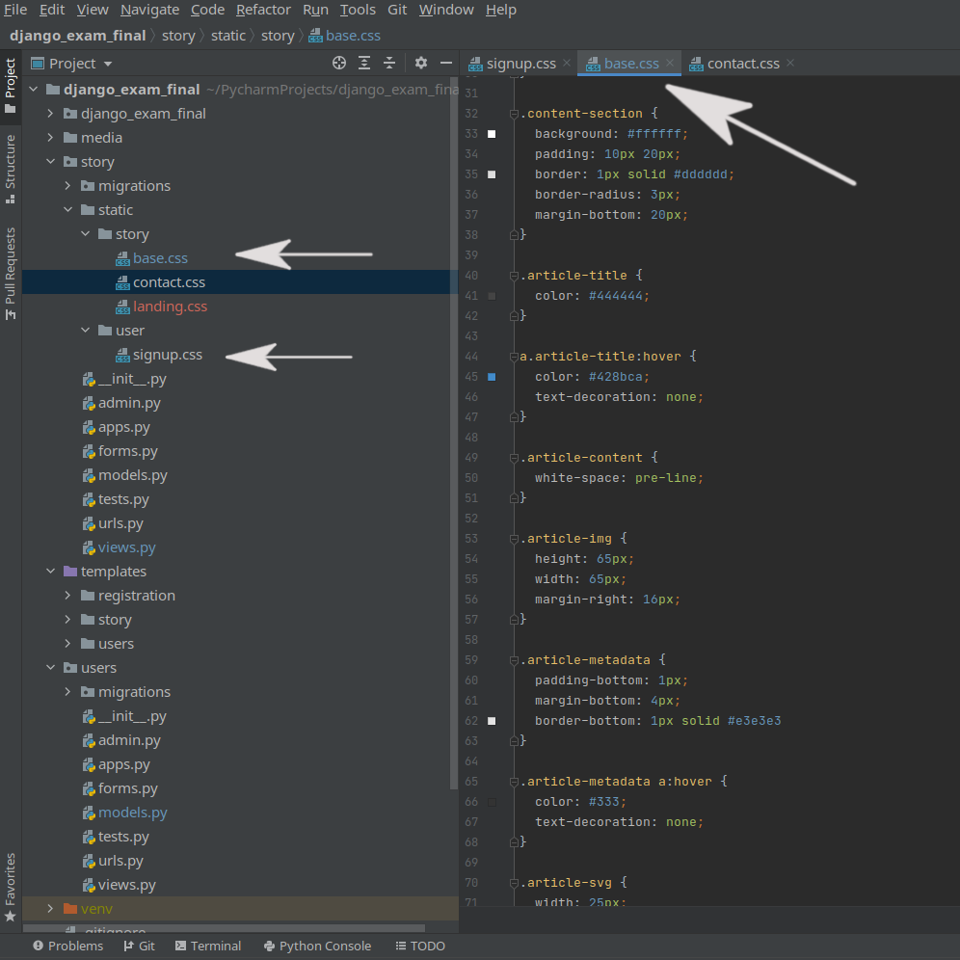
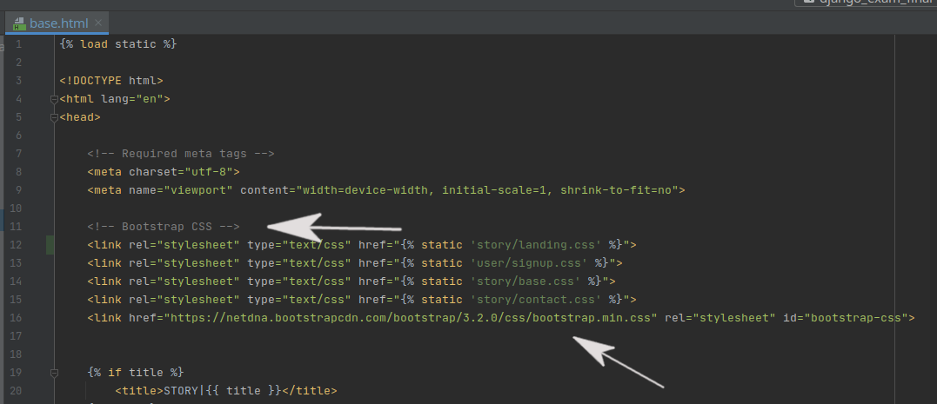
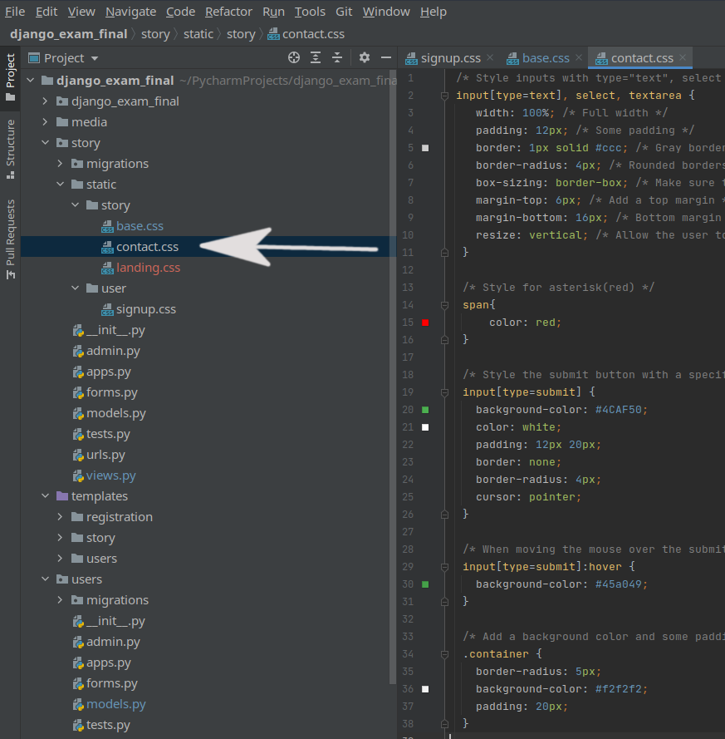
Optional
Custom CSS and Bootstrap

Slide 17
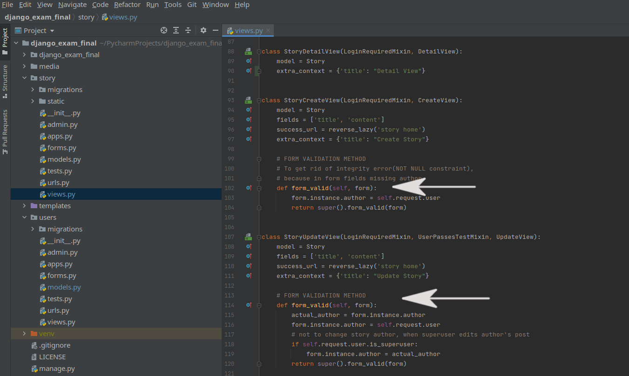
Optional
Form Validation

Slide 18
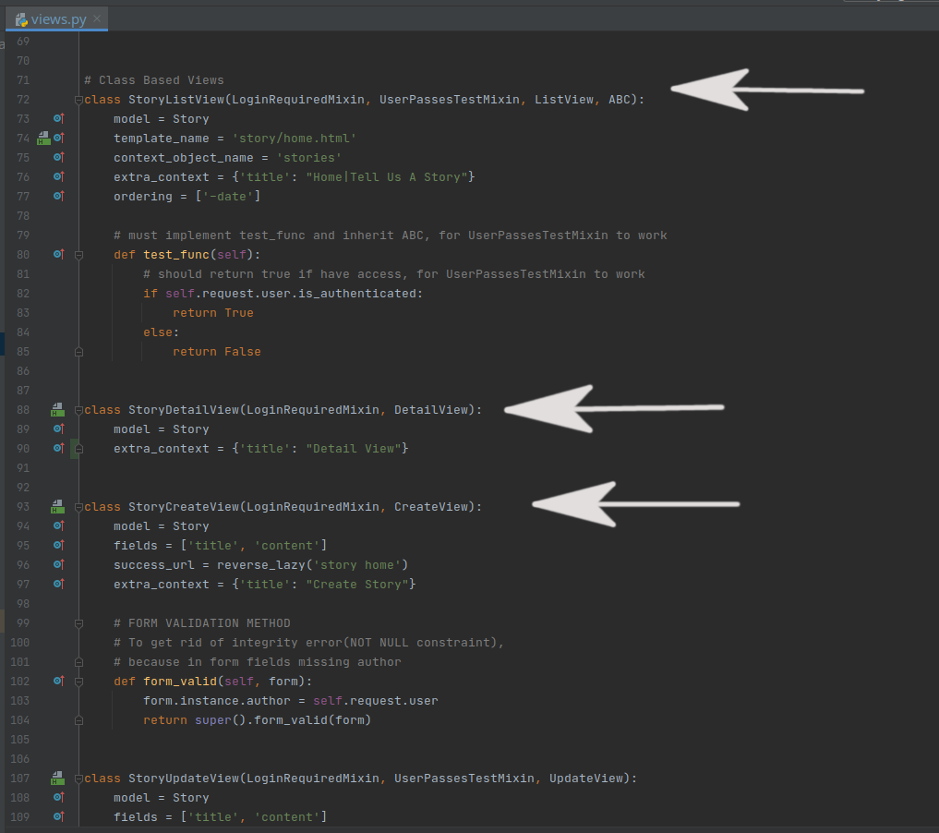
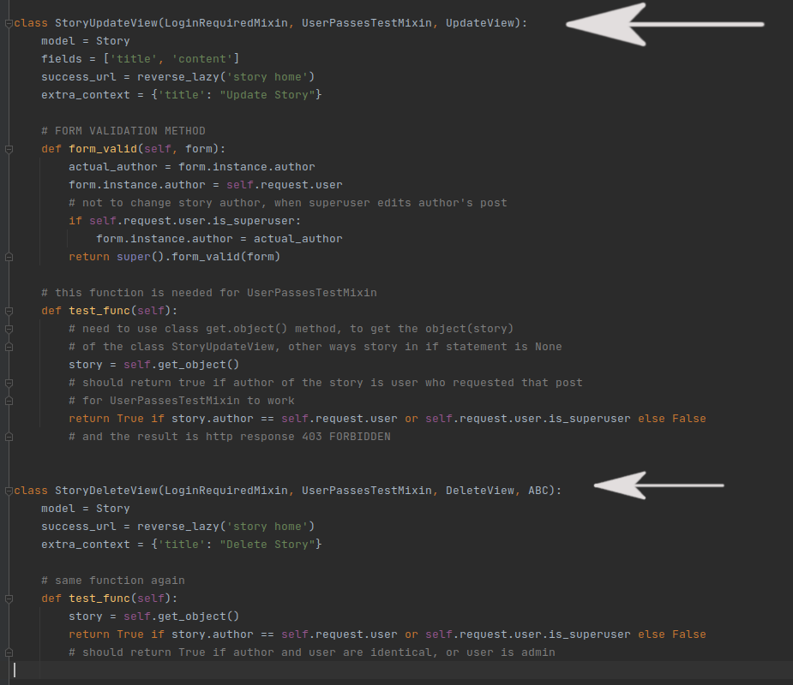
Optional
Class – based Views

Slide 19
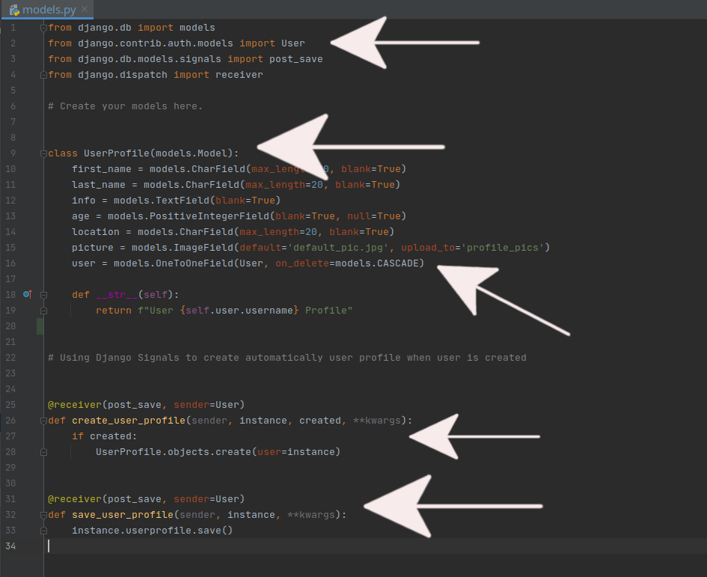
Optional
Extended Django User – One To One Field(Link) and Django Signals to create User Profile

